Slide 1
Chapter 3
Arithmetic for Computers

Slide 2
Integer Operations (3.1 to 3.4)
Addition and subtraction
Multiplication
Division
Dealing with overflow

Slide 3
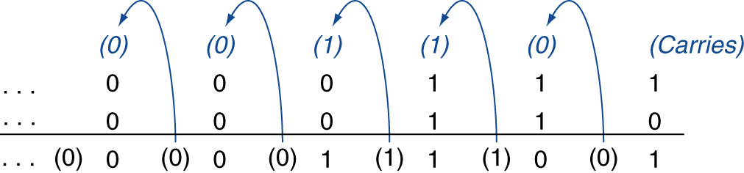
Integer Addition
Example: 7 + 6
Overflow if result out of range
Adding +ve and –ve operands, no overflow
Adding two +ve operands
Overflow if result sign is 1
Adding two –ve operands
Overflow if result sign is 0

Slide 4
Integer Subtraction
Add negation of second operand
Example: 7 – 6 = 7 + (–6)
+7: 0000 0000 … 0000 0111 –6: 1111 1111 … 1111 1010 +1: 0000 0000 … 0000 0001
Overflow if result out of range
Subtracting two +ve or two –ve operands, no overflow
Subtracting +ve from –ve operand
Overflow if result sign is 0
Subtracting –ve from +ve operand
Overflow if result sign is 1
Notes:
The 2s complement of a N digit binary number is its
2s complement conversion shortcut: Negate 6: 6 is 0110 change to 1001 + 1 = 1010
Negate -6 is 1010 becomes 0101 + 1 = 0110

Slide 5
Dealing with Overflow
Some languages (e.g., C) ignore overflow
Use MIPS addu, addui, subu instructions
Other languages (e.g., Ada, Fortran) require raising an exception
Use MIPS add, addi, sub instructions
On overflow, invoke exception handler
Save PC in exception program counter (EPC) register
Jump to predefined handler address
mfc0 (move from coprocessor reg) instruction can retrieve EPC value, to return after corrective action

Slide 6
Arithmetic for Multimedia
Graphics and media processing operates on vectors of 8-bit and 16-bit data
Use 64-bit adder, with partitioned carry chain
Operate on 8×8-bit, 4×16-bit, or 2×32-bit vectors
SIMD (single-instruction, multiple-data)
Saturating operations
On overflow, result is largest representable value
c.f. 2s-complement modulo arithmetic
E.g., clipping in audio, saturation in video

Slide 7
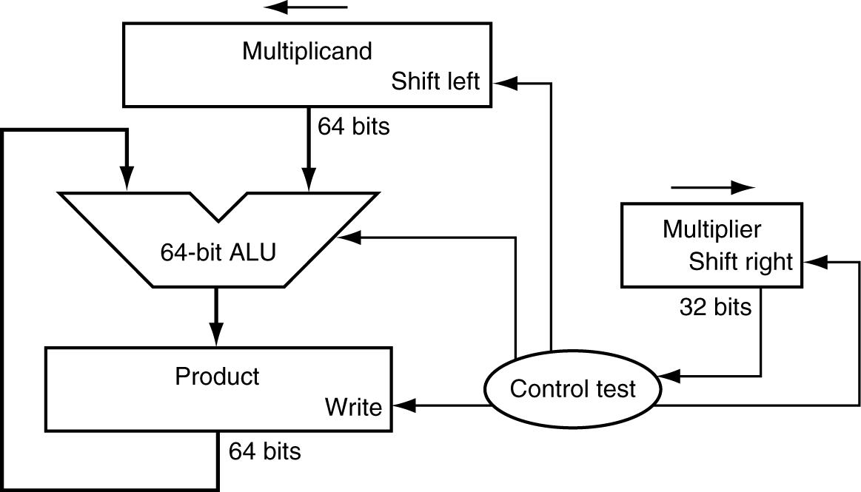
Multiplication
Start with long-multiplication approach
multiplicand
1000
× 1001
1000
0000
0000
1000
1001000
multiplier
product
Length of product is the sum of operand lengths

Slide 8
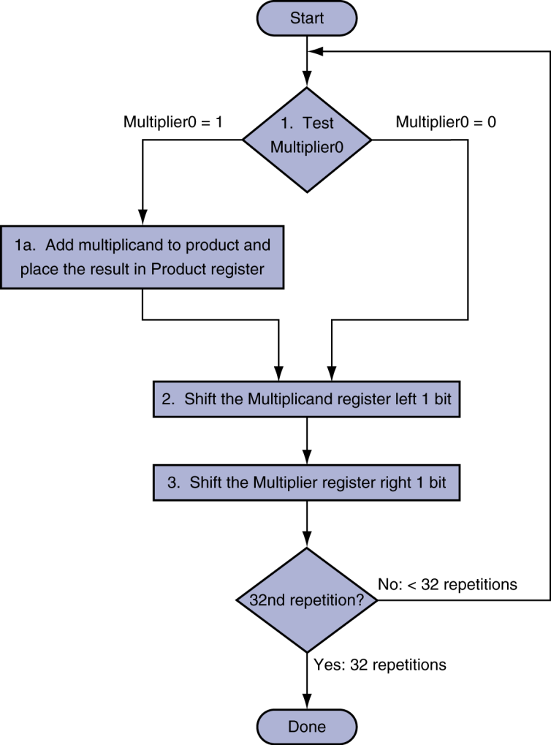
Multiplication Hardware
Initially 0

Slide 9
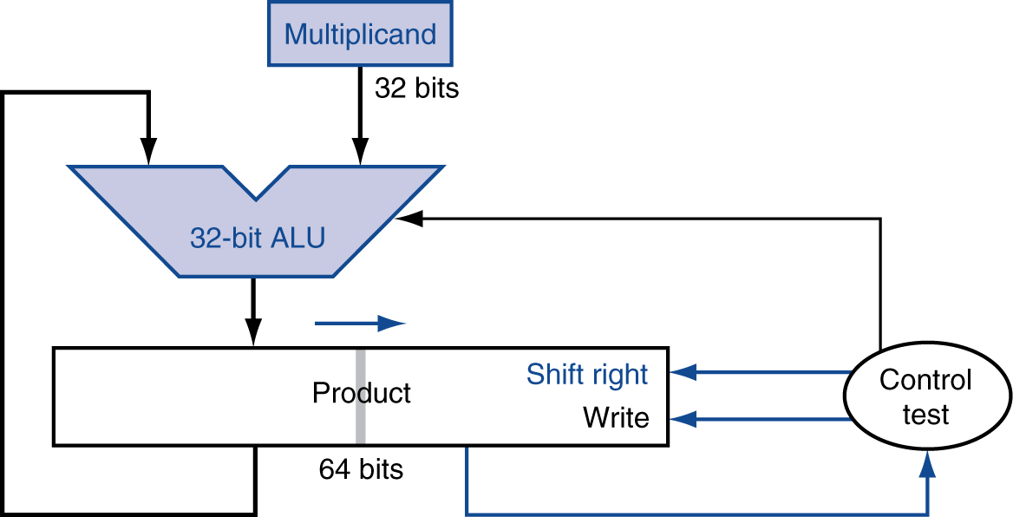
Optimized Multiplier
Perform steps in parallel: add/shift
Multiplier in right 32 bits initially
One cycle per partial-product addition

Slide 10
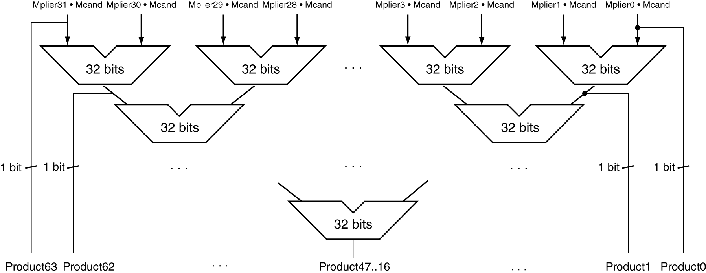
Faster Multiplier
Uses multiple adders
Cost/performance tradeoff
Can be pipelined
Several multiplication performed in parallel

Slide 11
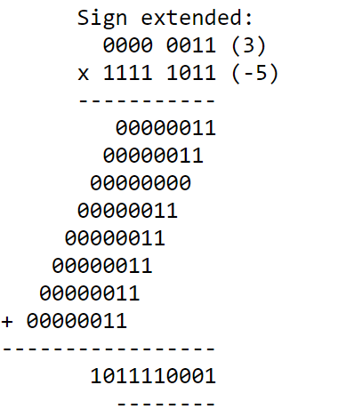
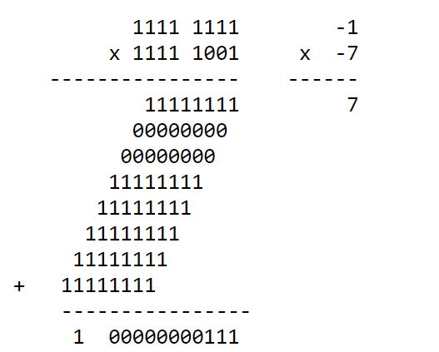
Signed Multiplication

Slide 12
MIPS Multiplication
Two 32-bit registers for product
HI: most-significant 32 bits
LO: least-significant 32-bits
Instructions
mult rs, rt / multu rs, rt
64-bit product in HI/LO
mfhi rd / mflo rd
Move from HI/LO to rd
Can test HI value to see if product overflows 32 bits
mul rd, rs, rt
Least-significant 32 bits of product –> rd

Slide 13
Division
Check for 0 divisor
Long division approach
If divisor ≤ dividend bits
1 bit in quotient, subtract
Otherwise
0 bit in quotient, bring down next dividend bit
Restoring division
Do the subtract, and if remainder goes < 0, add divisor back
Signed division
Divide using absolute values
Adjust sign of quotient and remainder as required
quotient
dividend
1001
1000 1001010
-1000
10
101
1010
-1000
10
divisor
remainder
n-bit operands yield n-bit quotient and remainder

Slide 14
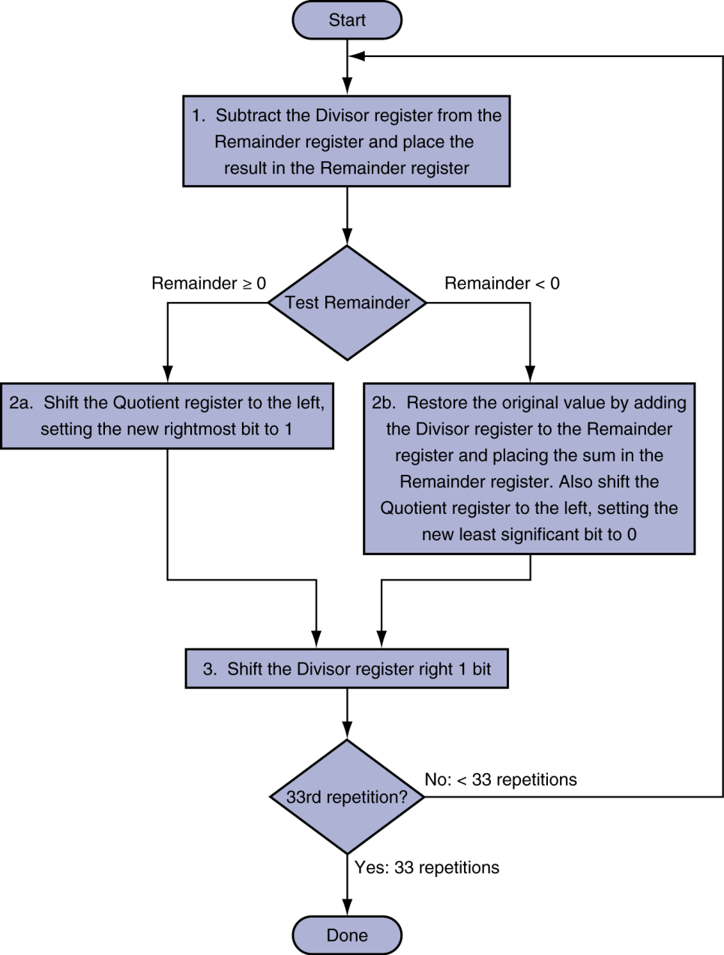
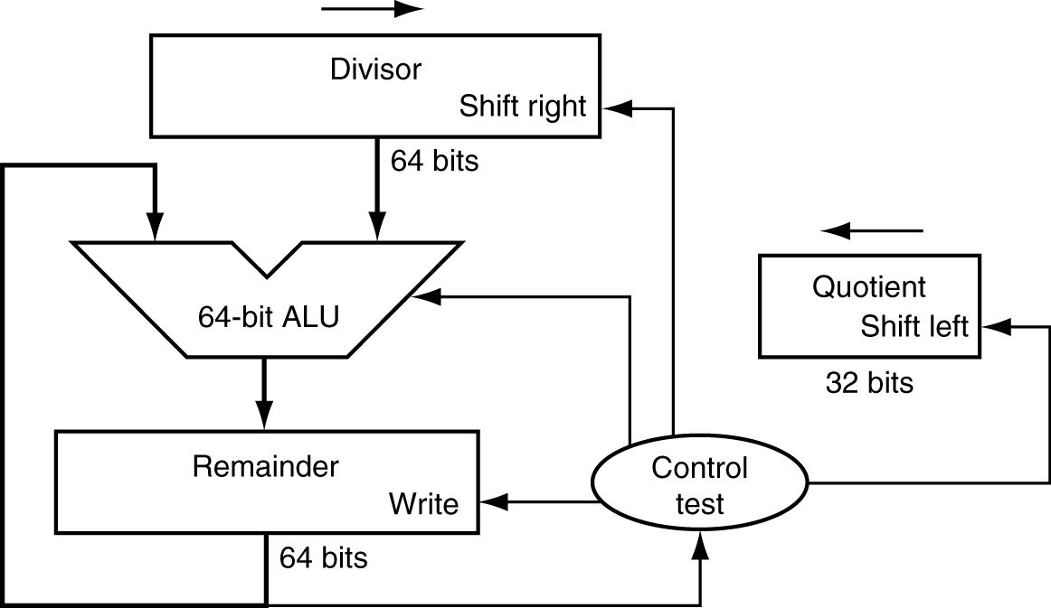
Division Hardware
Initially divisor in left half
Initially dividend

Slide 15
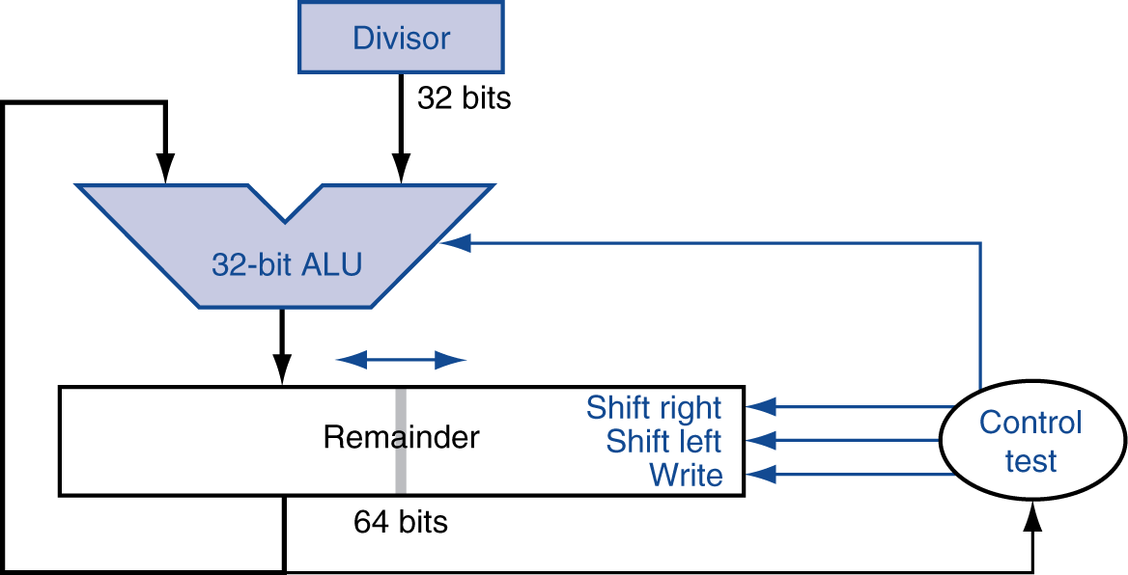
Optimized Divider
One cycle per partial-remainder subtraction
Looks a lot like a multiplier!
Same hardware can be used for both

Slide 16
Faster Division
Can’t use parallel hardware as in multiplier
Subtraction is conditional on sign of remainder
Faster dividers (e.g. SRT devision) generate multiple quotient bits per step
Still require multiple steps

Slide 17
MIPS Division
Use HI/LO registers for result
HI: 32-bit remainder
LO: 32-bit quotient
Instructions
div rs, rt / divu rs, rt
No overflow or divide-by-0 checking
Software must perform checks if required
Use mfhi, mflo to access result

